Slide 1
Bayesian Decision Theory
Parameter Estimation
Riquan Chen, Junxun Zhong, Weijiang Yu

Slide 2
Bayesian Decision Theory

Slide 3
Outline
1 Introduction
2 Losses and Risks
3 Discriminant Functions
4 Bayesian Networks

Slide 4
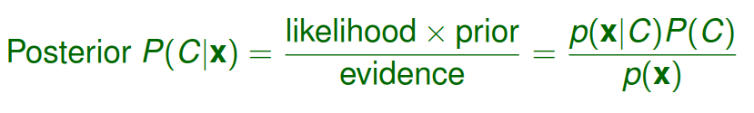
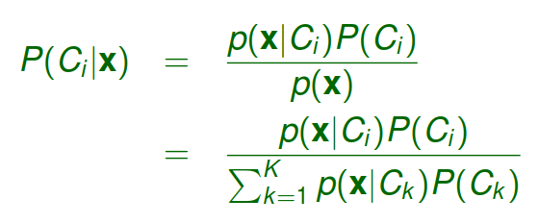
Bayes’ rule
Bayes’ rule for general case (K mutually exclusive and exhaustive classes):

Slide 5

Bayes’ rule
Optimal decision rule for Bayes’ classiﬁer:

Slide 6
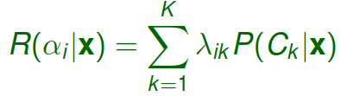

Losses and Risks
Action αi : decision to assign the input x to class Ci
Loss λik : loss incurred for taking action αi when the actual state if Ck
Expected risk for taking action αi :
Optimal decision rule with minimum expected risk:

Slide 7

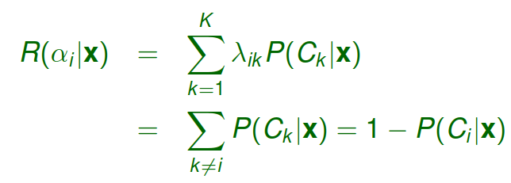

0-1 Loss
All correct decisions have no loss and all errors have unit cost:
Expected risk:
Optimal decision rule with minimum expected risk (or, equivalently, highest posterior probability):

Slide 8
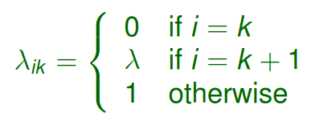
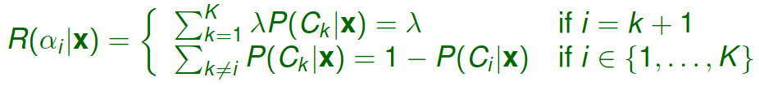
Reject Option
If the certainty of a decision is low but misclassiﬁcation has very high cost, the action of reject (αK +1 ) is preferred.
Loss function:
Expected risk:

Slide 9
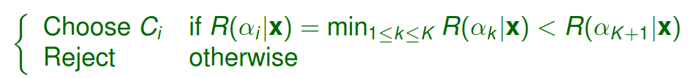

Reject Option
Optimal decision rule:
Equivalent form of optimal decision rule:
This approach is meaningful only if 0 < λ < 1:
If λ = 0, we always reject (a reject is as good as a correct classiﬁcation).
If λ ≥ 1, we never reject (a reject is as costly as or more costly than a misclassiﬁcation).

Slide 10
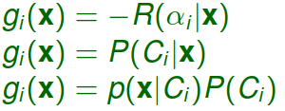

Discriminant Functions
One way of performing classiﬁcation is through a set of discriminant functions.
Different ways of deﬁning the discriminant functions:
Classiﬁcation rule:

Slide 11

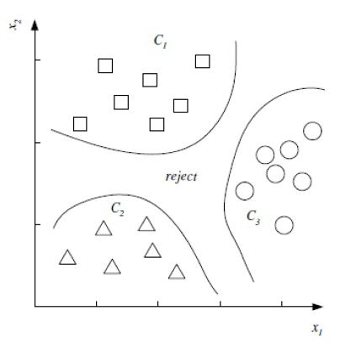
Decision Regions
The feature space is divided into K decision regions R1 , . . . , RK , where
The decision regions are separated by decision boundaries where ties occur among the largest discriminant functions.

Slide 12
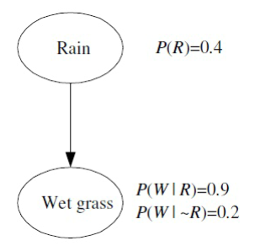
Bayesian Networks
Node (or vertex): random variable
Edge (or arc or link): direct inﬂuence between variables
Structure: directed acyclic graph (DAG) formed by nodes and edges
Parameters: probabilities and conditional probabilities

Slide 13

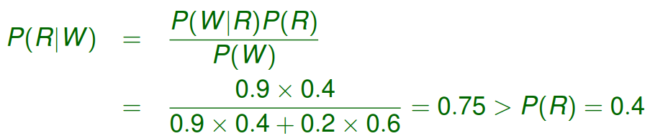
Causal Graph and Diagnostic Inference
Causal graph: rain is the cause of wet grass.
Diagnostic inference: knowing that the grass is wet, what is the probability that rain is the cause?
Bayes’ rule:

Slide 14
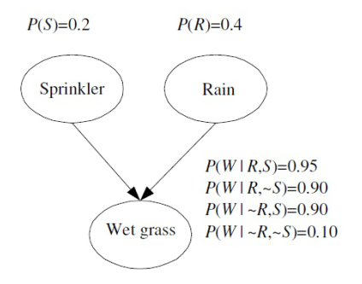
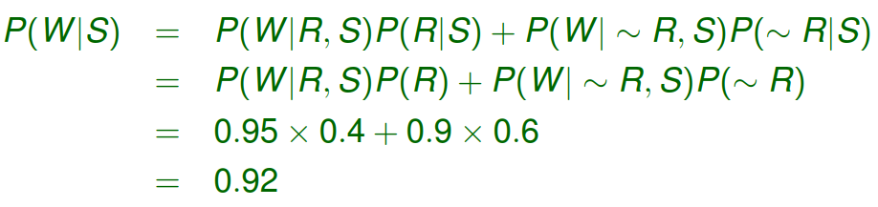
Two Causes: Causal Inference
Causal or predictive inference: if the sprinkler is on, what is the probability that the grass is wet?

Slide 15

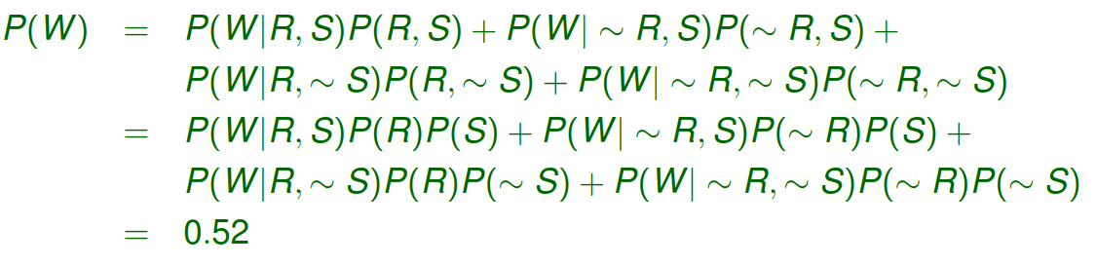

Two Causes: Diagnostic Inference
Diagnostic inference: if the grass is wet, what is the probability that the sprinkler is on?

Slide 16
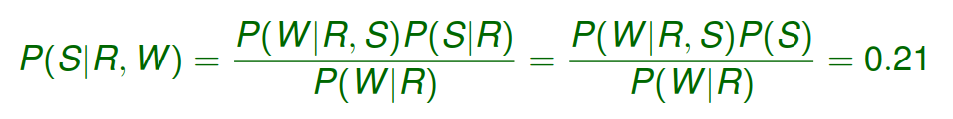

Two Causes: Diagnostic Inference
Diagnostic inference: given rain and wet grass, what is the probability that the sprinkler is on?
Bayes’ rule:
Knowing that it has rained decreases that probability that the sprinkler is on.

Slide 17
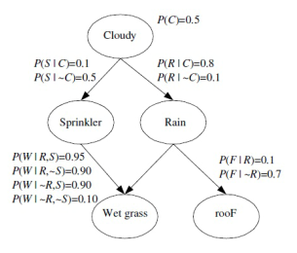
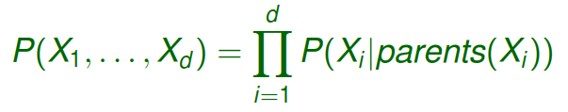
Local Structures
The network represents conditional independence statements.
The joint distribution can be broken down into local structures:
In general,
where Xi is either continuous or discrete with ≥ 2 possible values.

Slide 18
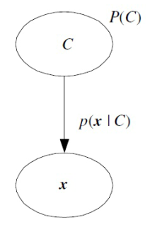
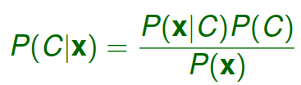
Bayesian Network for Classiﬁcation
Bayes’ rule inverts the edge:
Classiﬁcation as diagnostic inference.

Slide 19
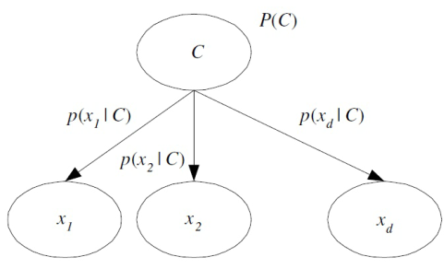
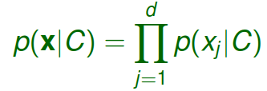
Naive Bayes’ Classiﬁer
Given C, the input variables xj are independent:
The Naive Bayes’ classiﬁer ignores possible dependencies among the input variables and reduces a multivariate problem to a group of univariate problems.

Slide 20
Parameter Estimation

Slide 21
Maximum Likelihood Estimation
e.g.Bernoulli/Multinomial/Normal…
Bayesian Estimation
e.g.Bayesian Estimation for Gaussian
Parametric Classification
Regression
e.g.MLER,BLR

Slide 22
Parameter estimation: assuming some parametric form for is estimated using X(density estimation)

Slide 23
p(x) follows a parametric model
e.g.,Gaussian

Slide 24
Two approaches to parameter estimation
Maximum Likelihood Estimation
(the parameter is a fixed point, point estimation)
Bayesian Estimation
(the parameter is a random variable)

Slide 25
Maximum Likelihood Estimation

Slide 26
Example : Bernoulli

Slide 27
Example : Multinomial

Slide 28
Example:Normal

Slide 29
Conclusion of MLE
The probability of every state
i.i.d（independent and identically distributed）

Slide 30
Bayesian Estimation
Unlike MLE which treats  as a fixed (but unknown) point, the Bayesian approach treats it as a random variable with prior density p() modeling the prior uncertainty about .
Assumption:
Destination:

Slide 31

The process

Slide 32
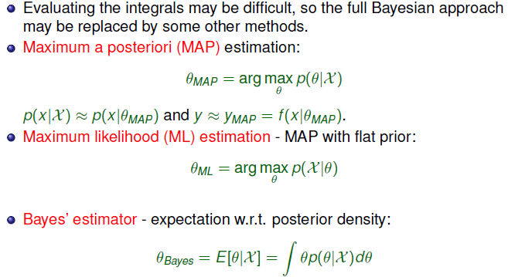

Slide 33
Conclusion

Slide 34
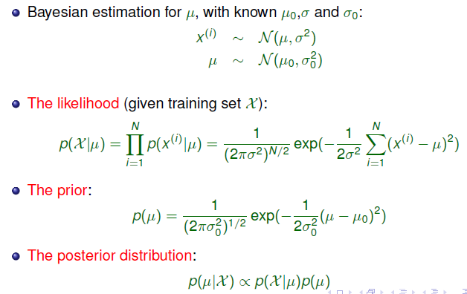
Example : Bayesian Estimation for Gaussian

Slide 36
Several applications based on ML and bayes’ estimation
Parametric Classification
Regression

Slide 37
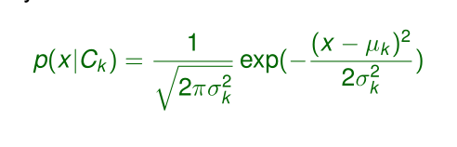
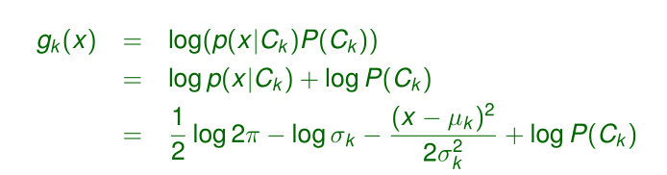
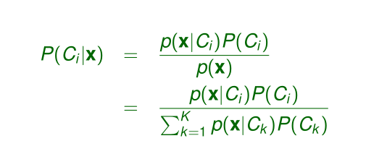
Classification with discriminant function
Assumption:
Discriminant function:
Bayesian Fomular

Slide 38


Rules for classification:

Slide 39


How to identify the discriminant functioin:
To estimate the parameters(Based on ML estimation)

Slide 40
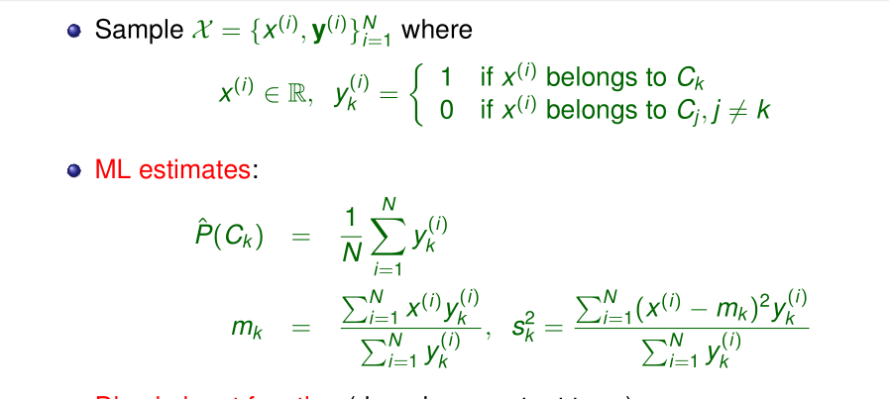
Example:

Slide 41
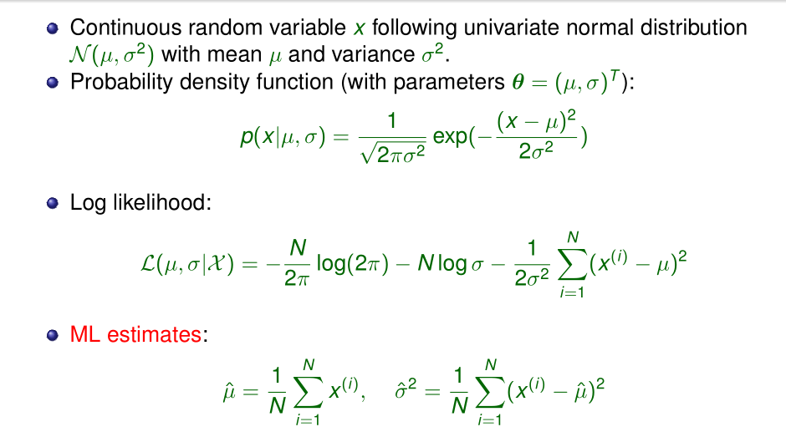

Slide 42
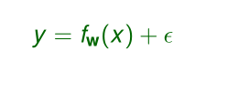

Additive Parametric Model
Basic Form:
is random noise independent of the input

Slide 43
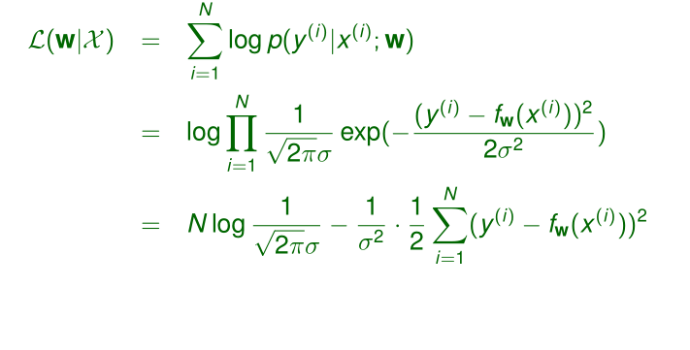
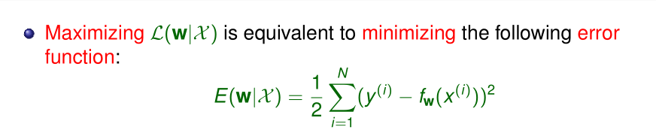
Log likelihood of Y

Slide 44
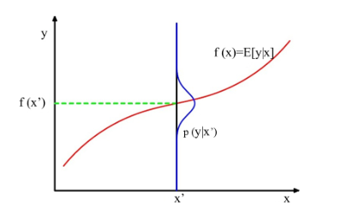
Interpretation of the least square estimation in the perspective of probability

Slide 45
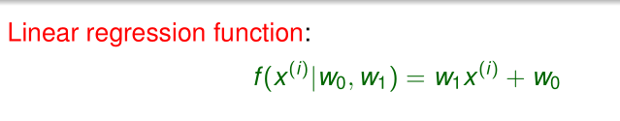
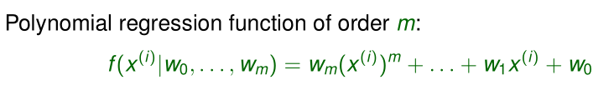
Common modeling function
1
2

Slide 46
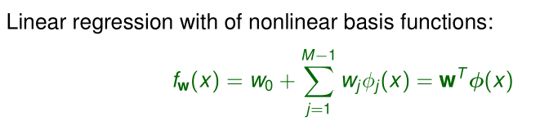
Generalized Linear Regression
Two way to optimize:
Gradient descence
In matric form

Slide 47
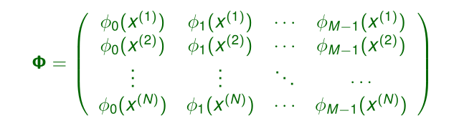

Slide 48
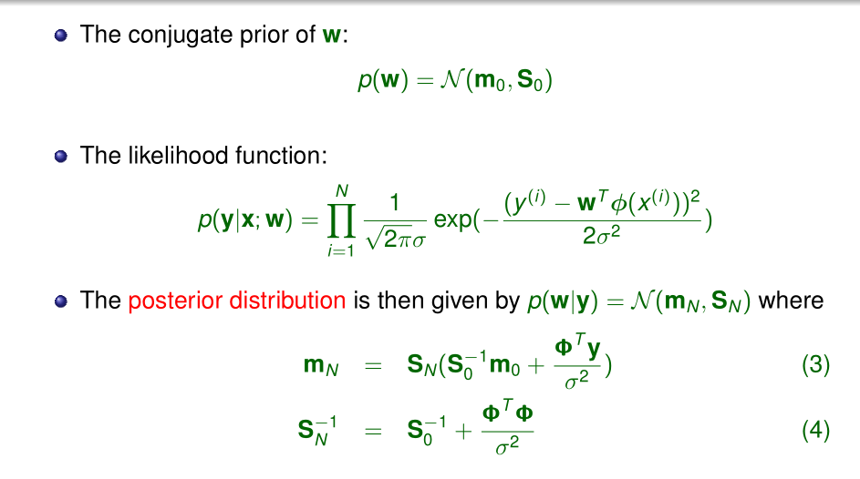
Bayesian Linear Regression

Slide 49
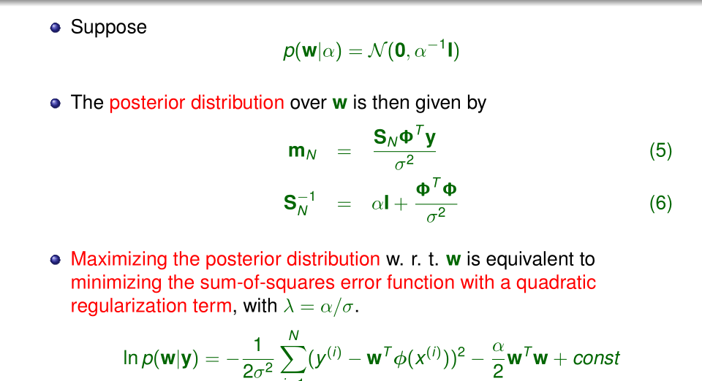

Slide 50
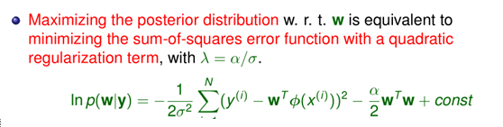
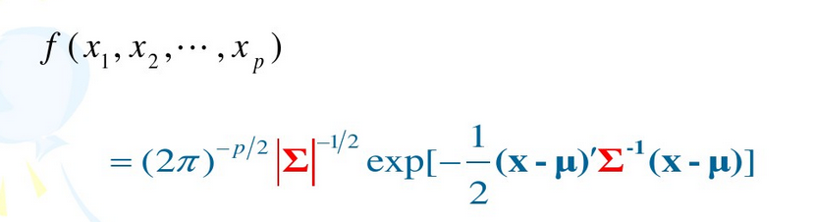
Probability density function of multivariate normal distribution:

Slide 51
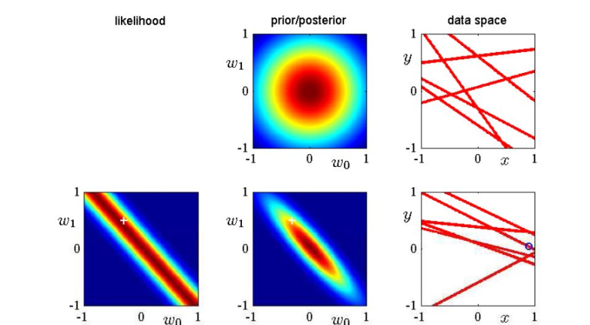

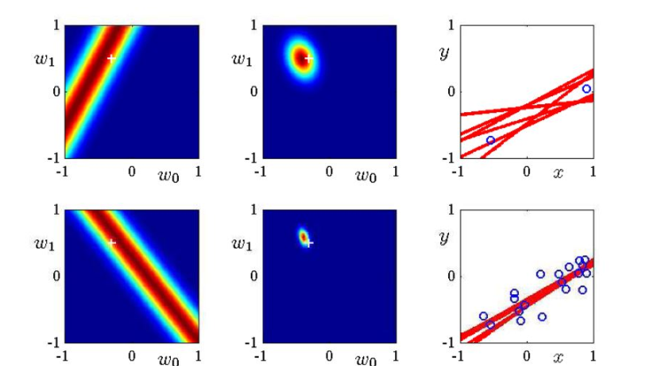

The posterior distribution：

